Slide 1

Hand gesture recognition
SRM INSTITUTE OF SCIENCE AND TECHNOLOGY
COLLEGE OF ENGINEERING AND TECHNOLOGY
DEPARTMENT OF NETWORKING AND COMMUNICATIONS
18CSP107L / 18CSP108L- MINOR PROJECT / INTERNSHIP
Student 1 Reg No: RA1911031010088
Student 2 Reg No:RA1911031010119
Batch ID:
Guide name: Dr. Praveena Akki
Designation: Assistant Professor NWC
Batch Id: NWC119088

Slide 2
Table of contents
· Project title
· Introduction – Problem statement / Objectives
· Literature Survey
· Architecture diagram / Block diagram of the modules
·UML Diagrams-ER diagrams/Use case diagram/Activity diagram (whichever is applicable)
· Algorithms used

Slide 3
Project Title
Hand gesture recognition

Slide 4
Introduction
Computer vision based techniques have the potential to
provide more natural and non-contact solutions,there are non invasive and are based on the way human beings perceive information about their surroundings. Although it is difficult to design a vision based interface for generic usage, yet it is feasible to design such an interface for a controlled environment but has no lake of challenges including accuracy, processing speed.

Slide 5
Problem Statement
In the traditional hand gesture recognition methods, lots of dependencies on gloves and sensors makes it more difficult to make some actual use of this field and makes it less flexible, but with development of technologies like Kinect sensor, provides new opportunities for human computer interaction. When we work on image dataset for better recognition the goal is to extract more features so that gesture recognition gives better results. It has been observed that if we extract more features, it is a lot easier to identify the hand gesture with better accuracy as well as accuracy can also be increased by improving the classification process. In this research a better feature extraction and hybrid classification is applied to enhance the result of the gesture recognition model.

Slide 6
Objectives
With development of technologies like Kinect sensor, provides new opportunities for human computer interaction. When we work on image dataset for better recognition the goal is to extract more features so that gesture recognition gives better results. It has been observed that if we extract more features, it is a lot easier to identify the hand gesture with better accuracy as well as accuracy can also be increased by improving the classification process. In this research a better feature extraction and hybrid classification is applied to enhance the result of the gesture recognition model.

Slide 7
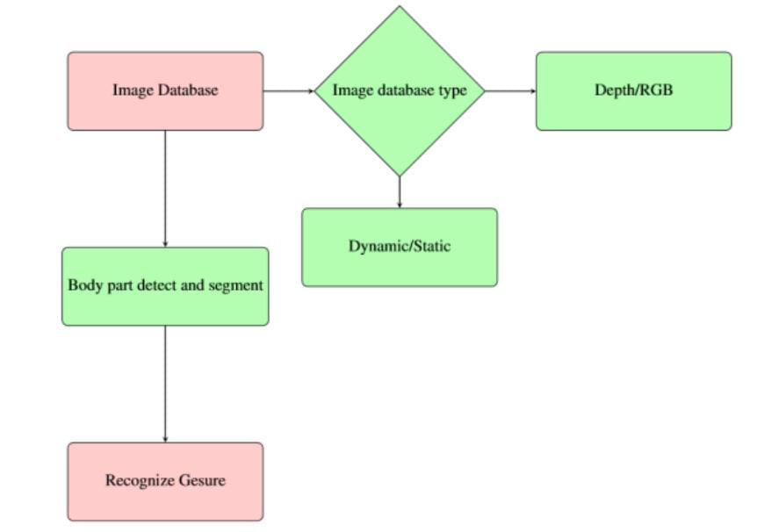
Architecture diagram

Slide 8
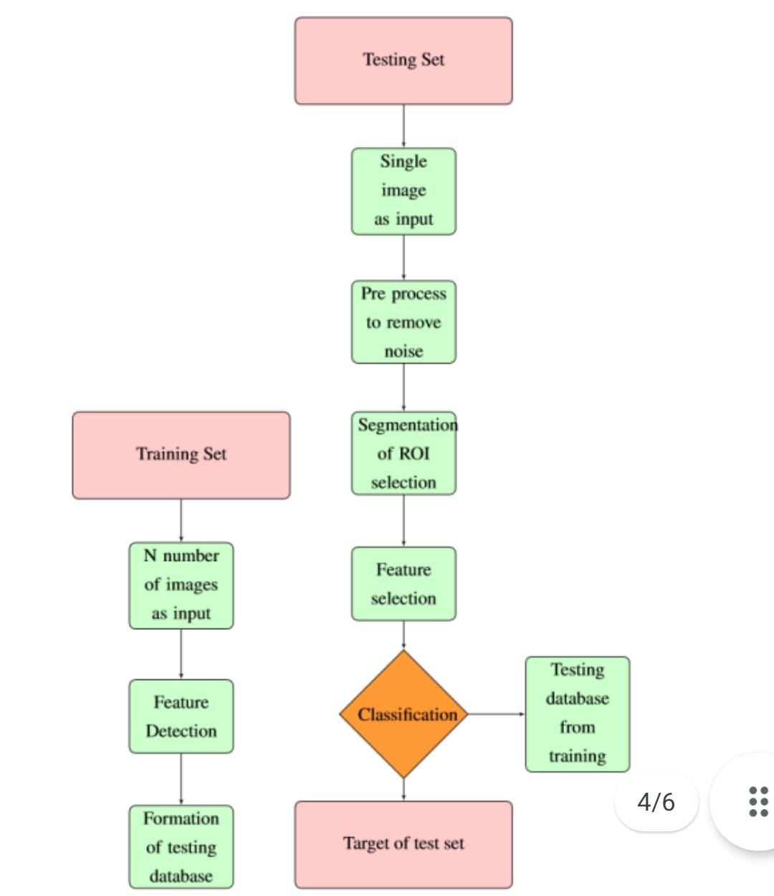
ER diagram

Slide 9
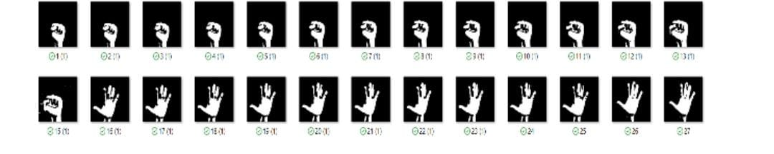
Literature Survey
The data set which I have used consisting of fist and palm images on which model is trained and then model is tested on the same data set which looks like this:

Slide 10
Algorithms used
In the segmentation image of fingers, the labeling algorithm is applied to mark the regions of the fingers.
In the process of recognition, the AdaBoost algorithm in machine learning is adopted firstly, by the help of Visual Gesture Builder to train the number gesture classifier, and export the classifiers to the recognition program to recognize the current gesture.
Finally, the dynamic time warping (DTW) algorithm is used to calculate the similarity between the test gesture and the template gesture for the extracted feature parameters, and then the recognition result is obtained.

Slide 11
Modules used
MediaPipe: Google created a framework for adaptable machine learning solutions called MediaPipe. It is a lightweight, cross-platform framework that is available under an open-source licence. Some pre-trained ML solutions are included with MediaPipe, including face detection, pose estimation, hand recognition, object detection, etc.
TensorFlow: The Google Brains team created the open-source TensorFlow library for machine learning and deep learning. While it may be used to many different tasks, deep neural networks are its main emphasis.
glob: Using precise pattern matching, this is used to locate all file paths.
csv (Comma Separated Values): Databases and spreadsheets may be read and written using these module objects.
skimage: Open source Python tool for image preprocessing that includes features like the greycomatrix (converts RGB image to grey scale)
numpy: This is a core Python library used for complex calculations, big mathematical operations, and the processing of enormous amounts of data.
sklearn: Python library for predictive analysis and classification of data.
pandas:It is a free software programme for manipulating data that is used to filter data frames.
matplotlib:This Python package is used to produce various charts and visualisations..
sys: This Python module gives users access to several variables and functions that are used to modify code in the runtime environment.

Slide 12
Platform
Anaconda: Anaconda is a platform for the distribution of computer languages used in scientific computing, such as Python (machine and deep learning applications, large scale data processing). To execute Python code for analysis and prediction, we utilised the Spyder IDE.

Slide 13
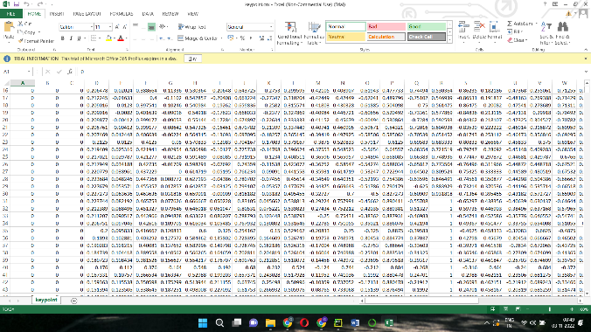
Testing database
Testing database:
A testing database with features and a target set will be used to record the training results in a csv file:

Slide 14
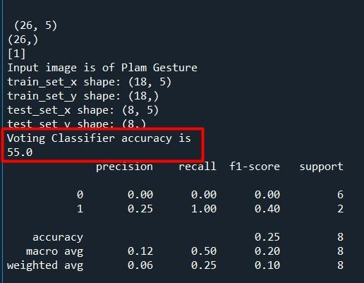
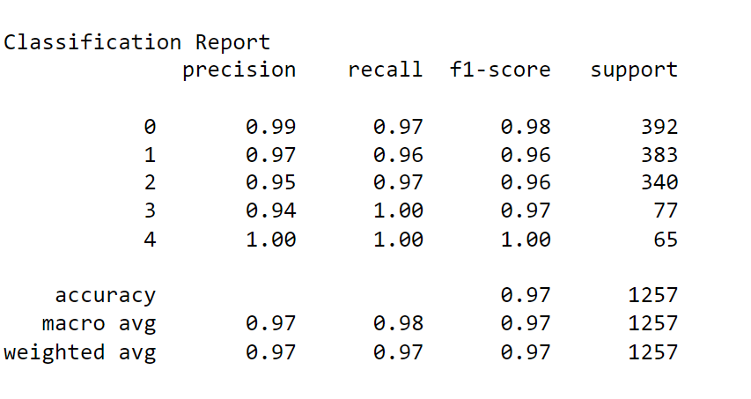
Result
Result of base paper implementation
Base paper python implementation gives 55% accuracy on the image dataset
Result of new implementation new implementation gives higher accuracy with proposed changes on
the same dataset

Slide 15
Conclusion
It has been noted that gesture detection is utilised in many industries and creates a bridge between human and computer connection and comprehension; as a result, it has to be applied to new domains in order to reap its advantages.
More effective object identification and detection techniques can be utilised to minimise the complexity in the future since gesture recognition uses advanced machine learning algorithms, which are quite difficult in terms of time complexity and efficiency.
Gaming is a very common trend among young people today, and since most popular games use gesture recognition, there is a significant chance that they will be used in the future. If we can improve accuracy by using various techniques, as I have suggested in my thesis, it could elevate user experience to a whole new level.

